Slide 1

IITM Madras, BS degree
BDM Project
RetailSense: A Data-Driven Approach to Retail Optimization
Uday Kiran
22f3001962

Slide 2


Organizational Background
UK-based online retail company
Specializes in giftware, homeware, and decorative products
Operates entirely through an e-commerce platform
Serves both B2C (individual customers) and B2B (wholesale clients)
Faces key challenges:
Low customer retention after first purchase
High return rates on specific items
Unpredictable sales and product performance

Slide 3
Problem Statement
Objectives
Segment customers based on purchase recency, frequency, and value
Analyze customer retention patterns over time (Cohort behavior)
Identify high-return products and customers causing revenue loss
Discover product combinations frequently bought together (bundling)
Measure revenue concentration across customers and products using CLV and Pareto
Recommend actions to reduce returns and increase repeat sales

Slide 4
Data Summary:
Methods & Tools Used:
Source: UCI Online Retail Dataset
Records: 541,909 transactions
Time Period: Dec 2010 to Dec 2011
Fields: InvoiceNo, Product, Quantity, UnitPrice, CustomerID, Country, InvoiceDate
Key Issues: Missing values (CustomerID, Description), Returns (negative Quantity)
Data Cleaning & Feature Engineering (Revenue, Cohort Index, Tenure)
RFM Segmentation for customer value grouping
Cohort Analysis for retention patterns
Market Basket Analysis using Apriori algorithm
Return Analysis to identify loss-heavy SKUs/customers
CLV Calculation + Pareto Analysis for revenue concentration

Slide 5
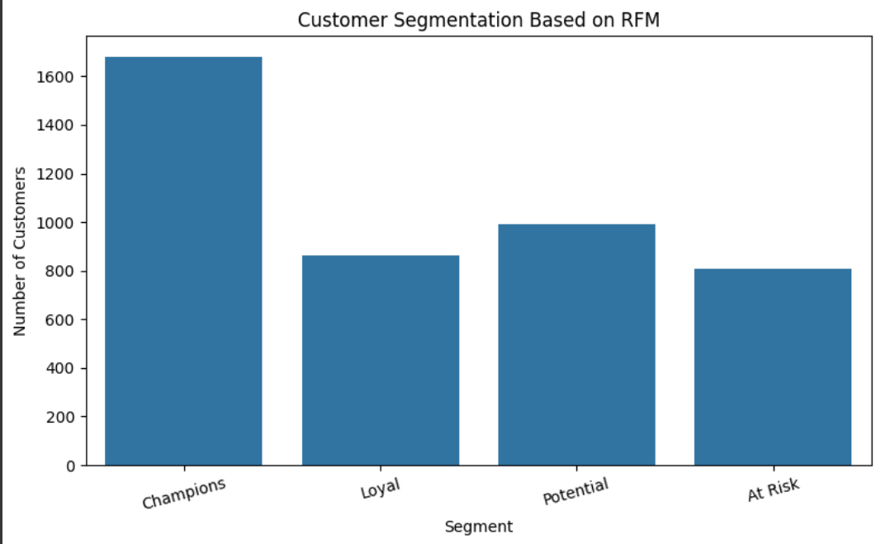
Customer Segmentation (RFM)
Segmented customers using Recency, Frequency, and Monetary value
Assigned RFM scores and labeled 4 segments: Champions, Loyal, Potential, At Risk
Most revenue driven by Champions (~1,600+ high-spending customers)
At Risk segment large and under-engaged
Insights used to tailor loyalty programs and retention strategie

Slide 6
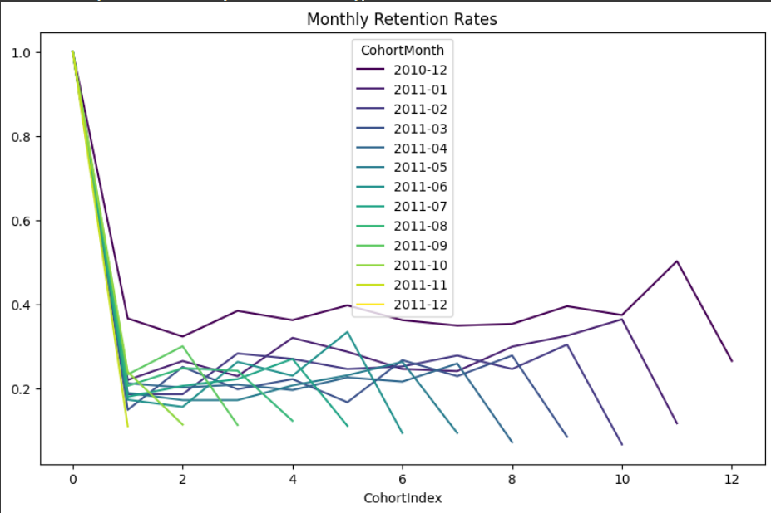
Cohort analysis
Customers grouped by month of first purchase (CohortMonth)
Tracked activity month-over-month (CohortIndex)
Steep drop in retention after Month 1 across all cohorts
Retention stabilizes at ~15–25% by Month 2
Indicates need for stronger post-purchase engagement in first 30 days

Slide 7
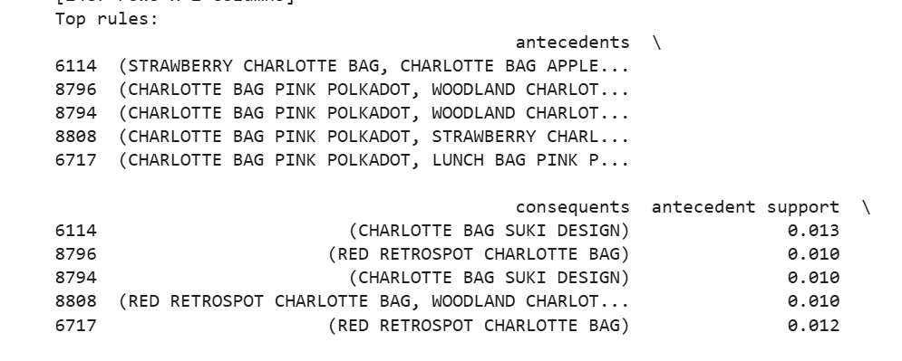
Market Basket Analysis
Used Apriori algorithm to find frequent product combinations
Over 2,400 frequent itemsets (2+ items) identified
Top rules had 100% confidence and very high lift (up to 71×)
Example:
PACK OF 72 SKULL CAKE CASES + CHARLOTTE BAG PINK POLKADOT → PACK OF 72 RETROSPOT CAKE CASES
Insights help drive bundle promotions and in-cart recommendations

Slide 8
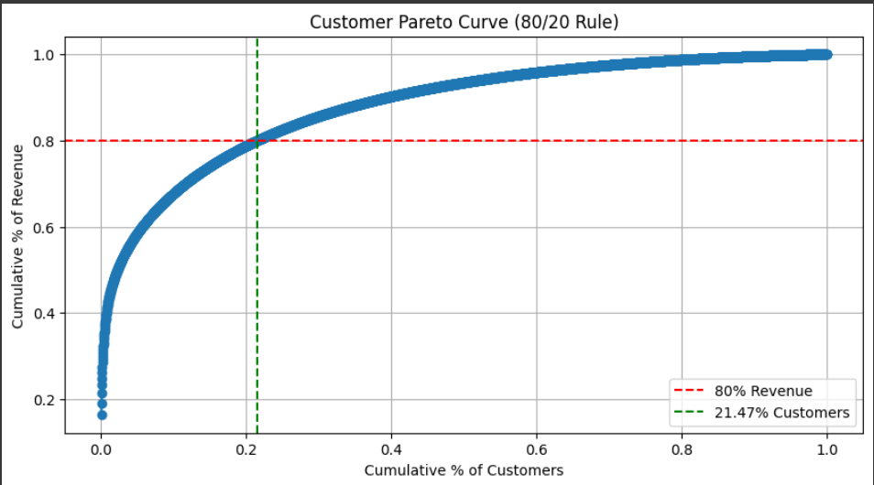
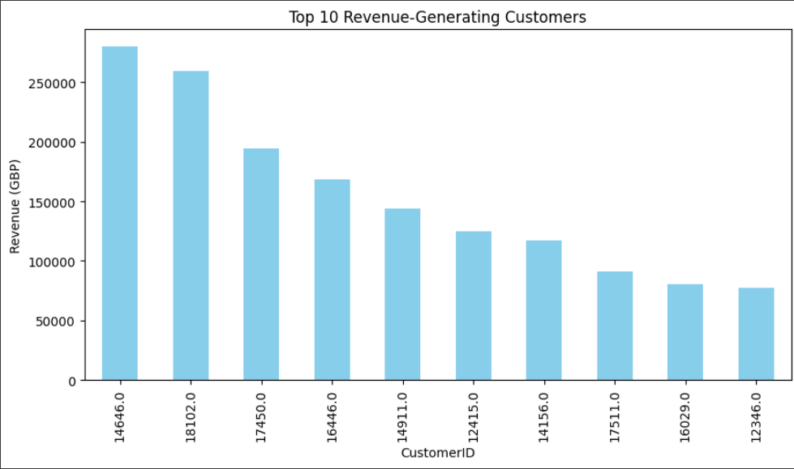
CLV and Pareto Analysis
CLV calculated as Frequency × Monetary (RFM-based)
Top 5 customers generated CLV ranging from ₹9M to ₹3.8B
Clear concentration of business value across few entities
Pareto analysis confirmed classic 80/20 rule:
Top 21.5% of customers → 80% of revenue
Top 20% of products → 80% of revenue

Slide 9
Recommendations
Loyalty programs: To engage high-RFM and high-CLV customers.
Re-engagement offers: Target “At Risk” customers within first 30 days using re-engagement offers
Bundle frequently paired products to boost cart value.
Refine return policies for high-loss SKUs and frequent returners
Focus inventory: and marketing on top 20% products and customers
Better Data Management: Improve data collection on customer identities, ask for reviews, reasons for returns etc.
Targeted Marketing: Use segmentation insights to offer promotions for regular shoppers and exclusive perks for high-value customers.

Slide 10
Thank You

